Slide 1
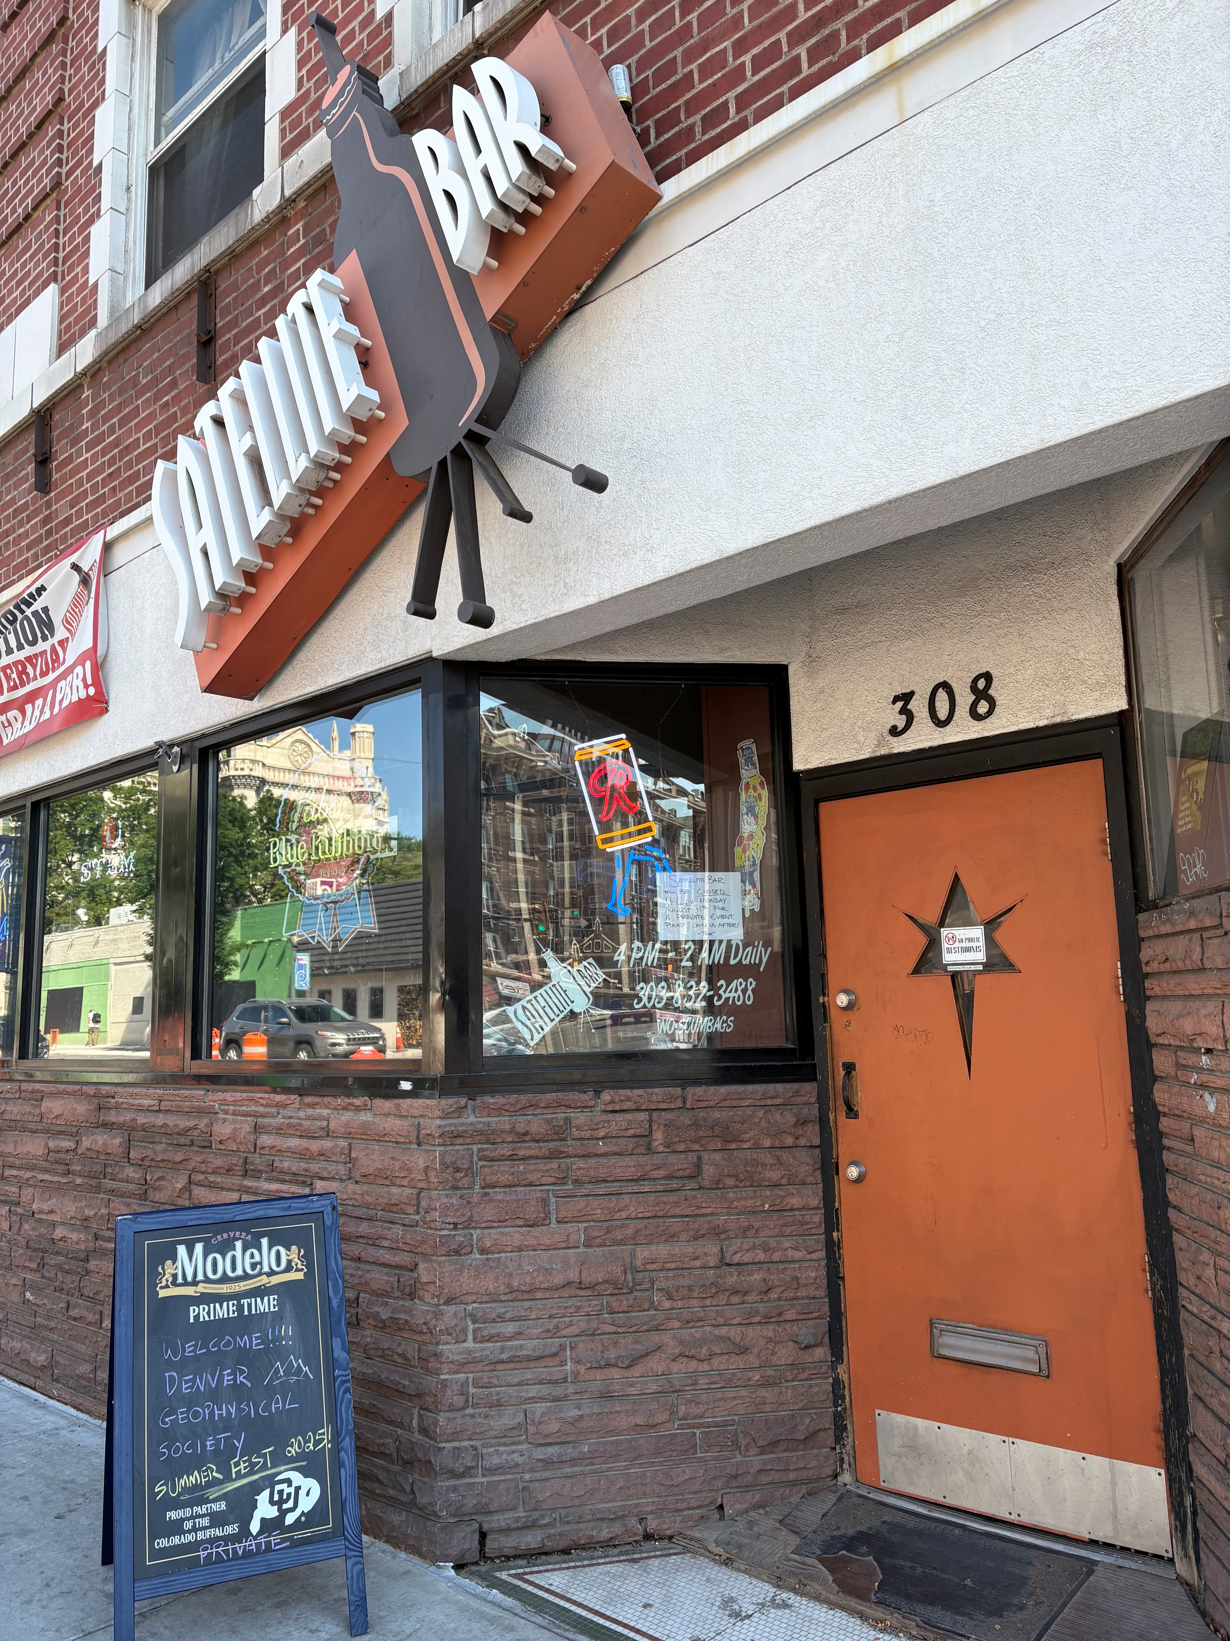
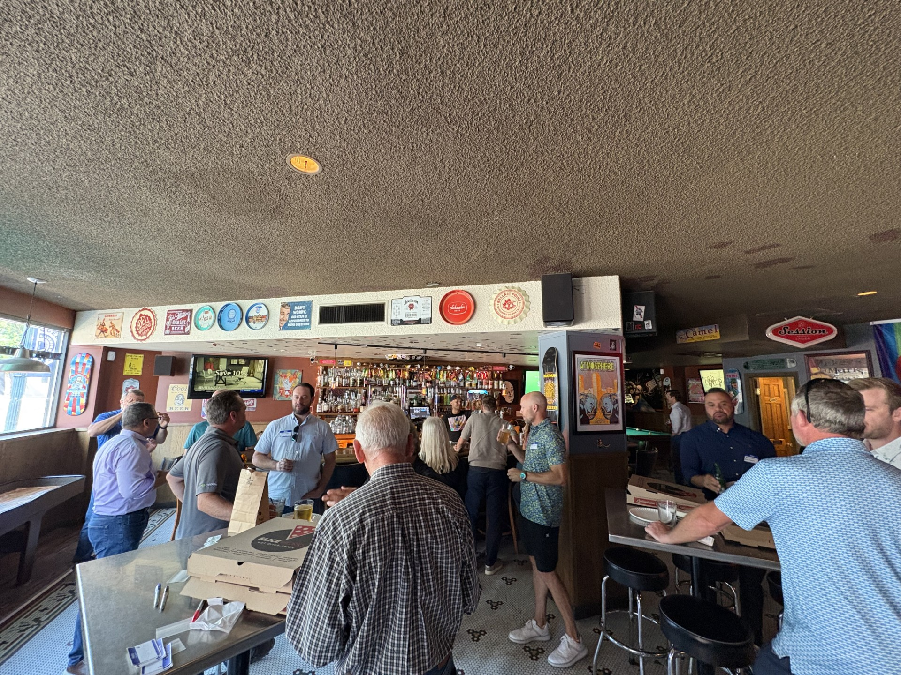
2026 DGS Summer Fest
July 27, 2026 from 4PM – 6PM
Satellite Bar @ 308 E Colfax Ave, Denver, CO
Free SliceWorks Pizza (best NY-style pie in town)
Entire bar closed down 4-6PM
Door prizes and silent auctions
Networking, pool, music, arcade games
FREE for ANYONE!
Don’t miss out, come celebrate with us before the golf tournament!
https://denvergeo.org/events/2nd-annual-dgs-summer-fest/

